Slide 1
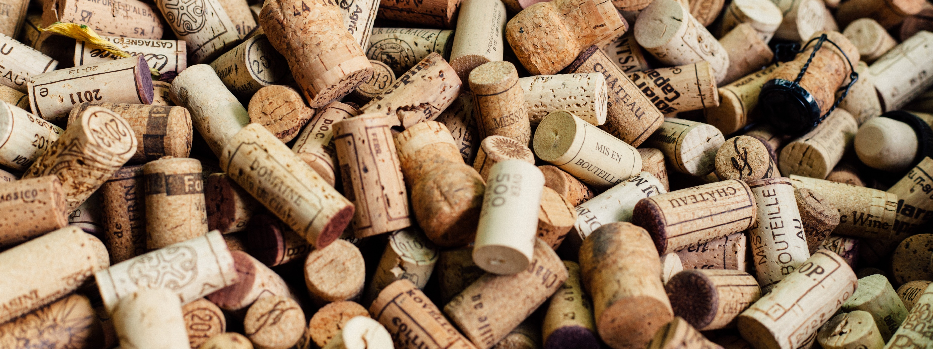
WINES OF THE WORLD Data Analytics Bootcamp UC Berkeley Extension 06.19.2018
Janaki Kora
Jessica Phillips
Lena Tran
Naz Sinaei
Sema Uyar

Slide 2

outline
Our goal
Our data set
Data and database engineering
Methods
Website
Improvements for future
Questions

Slide 3
Our goal
Our goal is to help users find the best wine producers for their selected variety of wine, and its price!
Users who navigate our site can find:
Top 10 rated wine brands for selected variety of wine
Top countries producing selected variety of wine
Rating vs. price of selected variety of wine, and its brand
A world map that shows where the wines are produced

Slide 4
Our Data Set
For our project, we are using data…
That was scraped from “Wine Enthusiast” by Zack T., “a full-stack software engineer who loves data science”
Our data set includes:
~130k wine reviews
13 data fields (Points, Title, Variety, Description, Country, Province, Region 1, Region 2, Winery, Designation, Price, Taster Name, Taster Twitter handle)
Our data sources:
https://www.kaggle.com/zynicide/wine-reviews/data
https://github.com/zackthoutt/wine-deep-learning

Slide 5
Data & database engineering
Data Engineering Steps:
Pull the wine data set CSV file into a Pandas dataframe, and clean up the NULL values for the price field
Utilize a Python library (‘Geocoder’) to get latitude and longitude coordinates of unique regions in our data set
Database Engineering Steps:
Create Sqlite database (‘Wine.sqlite’) that includes two tables :
Wine data
Region coordinates

Slide 6
Methods
Flask App / SQLAlchemy
Bootstrap
JavaScript Libraries:
- D3
- Plotly
- Leaflet

Slide 7
Website

Slide 8
IMPROVEMENTS for future
Make bubble-chart and Top 10 panel interactive with the selection of both the country and the wine variety
Improved interaction with the map

Slide 9
Questions?

Slide 10
Thank you!

